Slide 1
Implementation of Cleanlab Himanshu, MDS202327

Slide 2
The dataset : CMU Face Images
Description
This data consists of 640 black and white face images of people. Each image can be characterized by the pose (straight, left, right, up), expression (neutral, happy, sad, angry), eyes (wearing sunglasses or not).
This directory contains 20 subdirectories, one for each person, named by userid. There are 32 images for each person capturing every combination of features.
16 of the 640 images have glitches due to problems with the camera setup; these are the .bad images
Naming convention of images
<userid><pose><expression><eyes><scale>.pgm
Images with scale 1 were selected i.e. full-resolution image (120x128) which has the convention <userid><pose><expression><eyes>.pgm

Slide 3
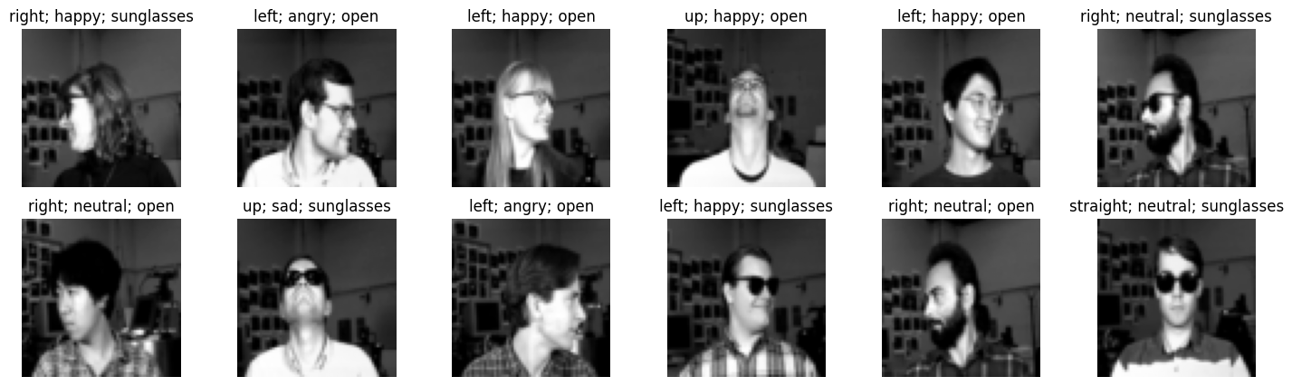
Sample of data

Slide 4
Approach
1
2
3
4
5
6
Design the model architecture(s)
Load the data into a data loader using custom class
Train the model
Observe the result and possible issue(s)
Use Cleanlab to get cleaned data with issues removed
Compare the results

Slide 5
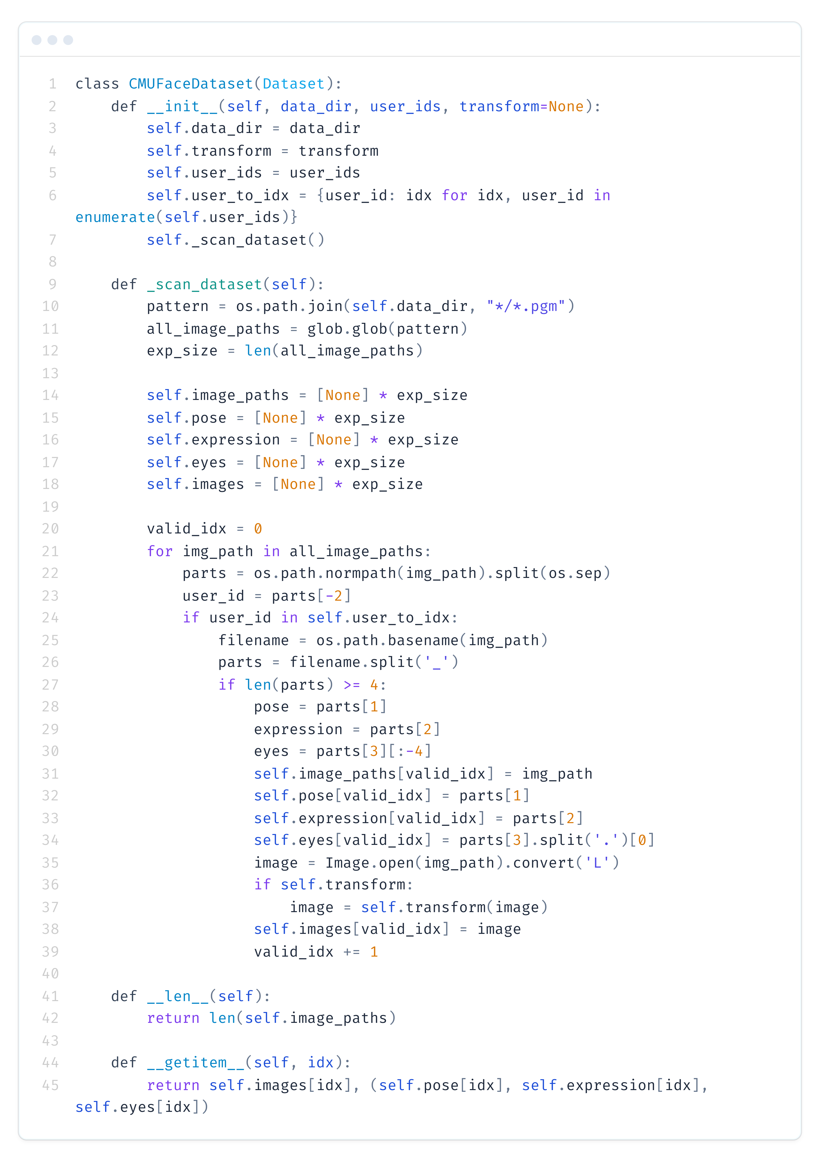
Custom Data Loader
Important features
Filter the .bad images using glob
Fixed length lists for speed up
Leveraging the structure of file name to get the values for pose, expression, eyes
Return image (for visualization) and tuple(pose, expression, eyes)

Slide 6
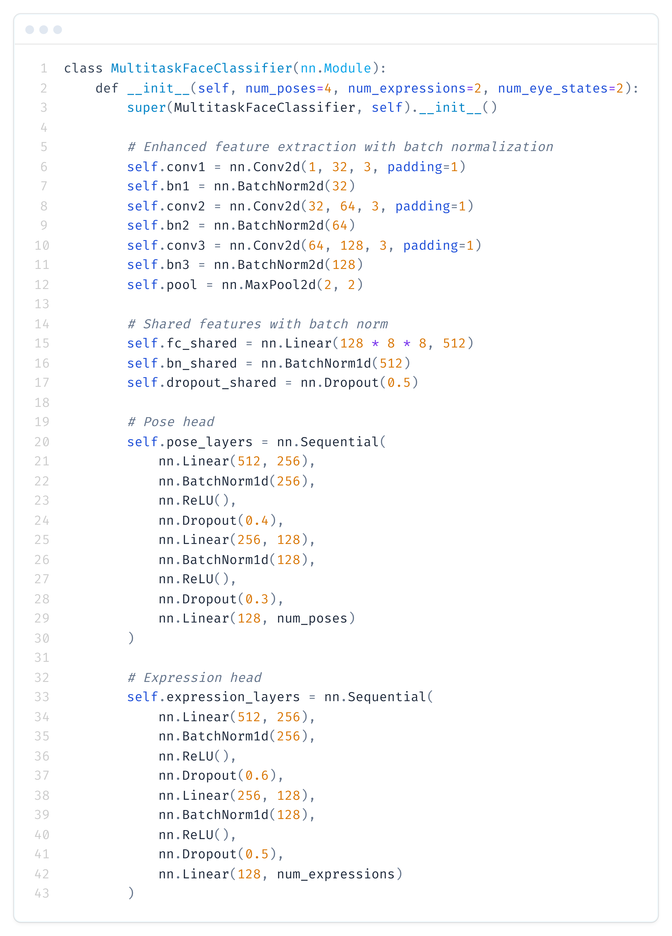
Model Architecture
CNN
CNN based classifier with convolution layer and max pooling layer
Task-specific heads with intermediate layers
Dropout, Batch Norm layers to control risk of overfitting

Slide 7
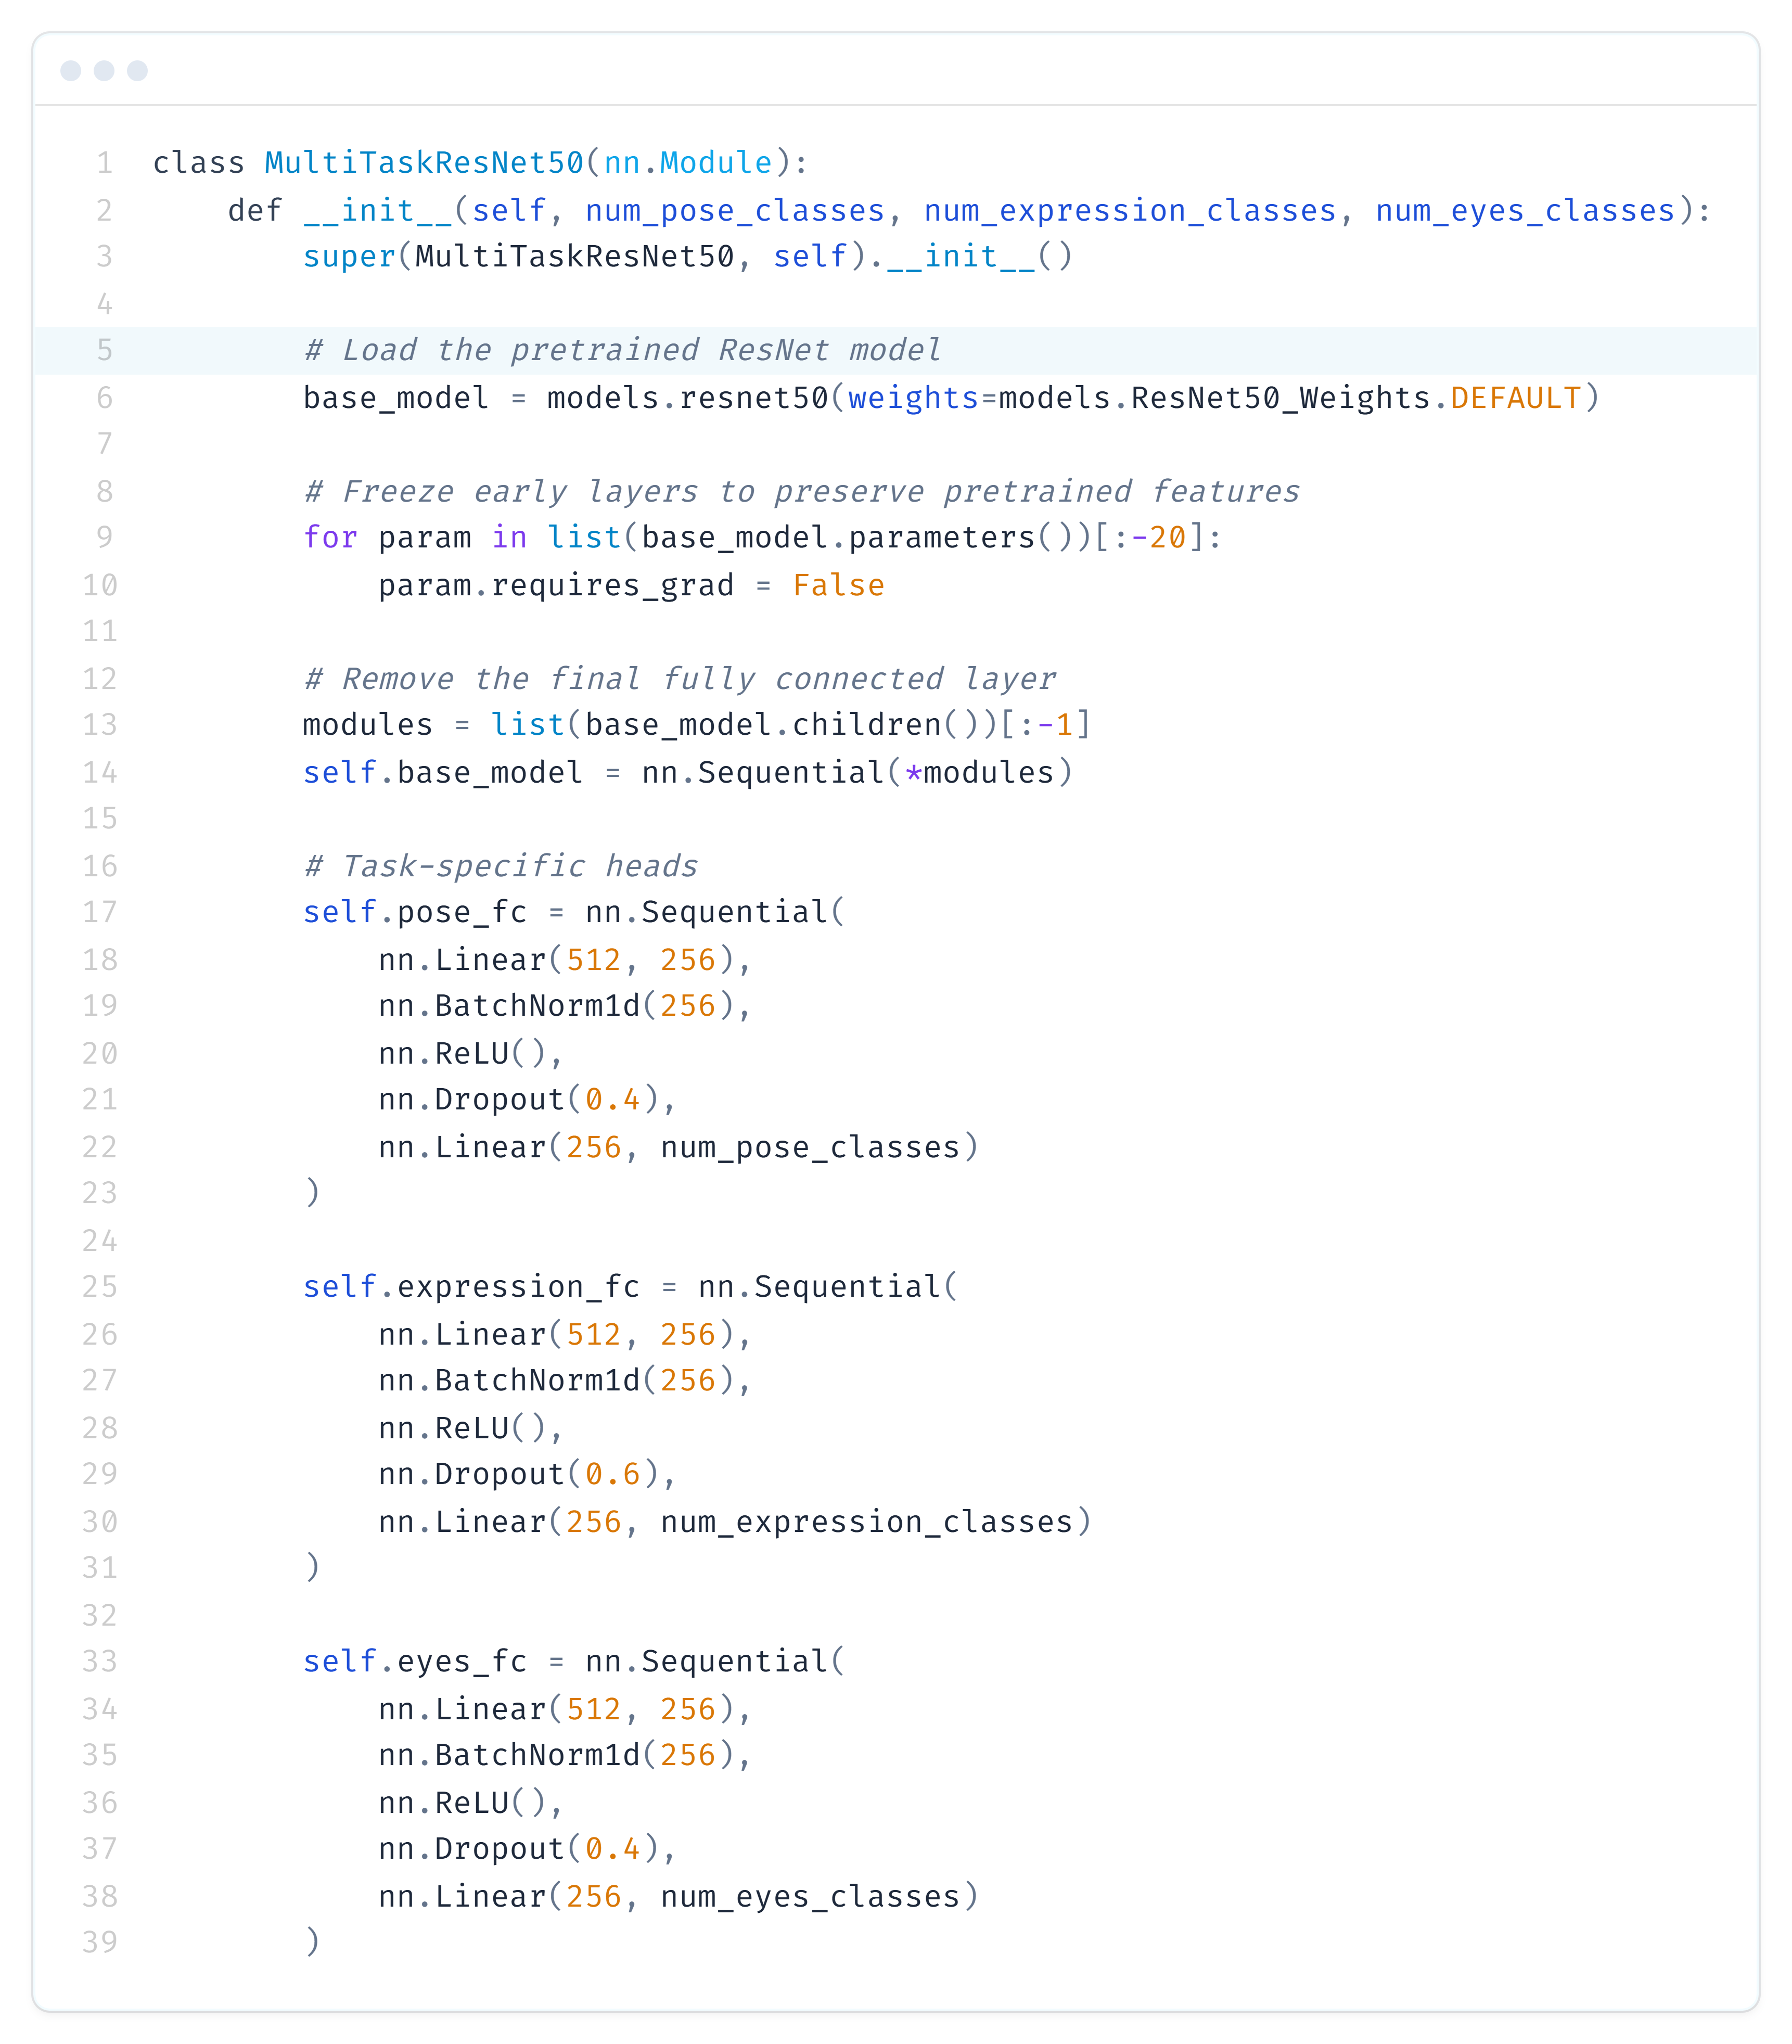
Model Architecture
CNN
CNN based classifier with convolution layer and max pooling layer
Task-specific heads with intermediate layers
Dropout, Batch Norm layers to control risk of overfitting
ResNet50
Use pretrained weights
Freeze early layers
Task-specific heads with Dropout, Batch Norm layers

Slide 8
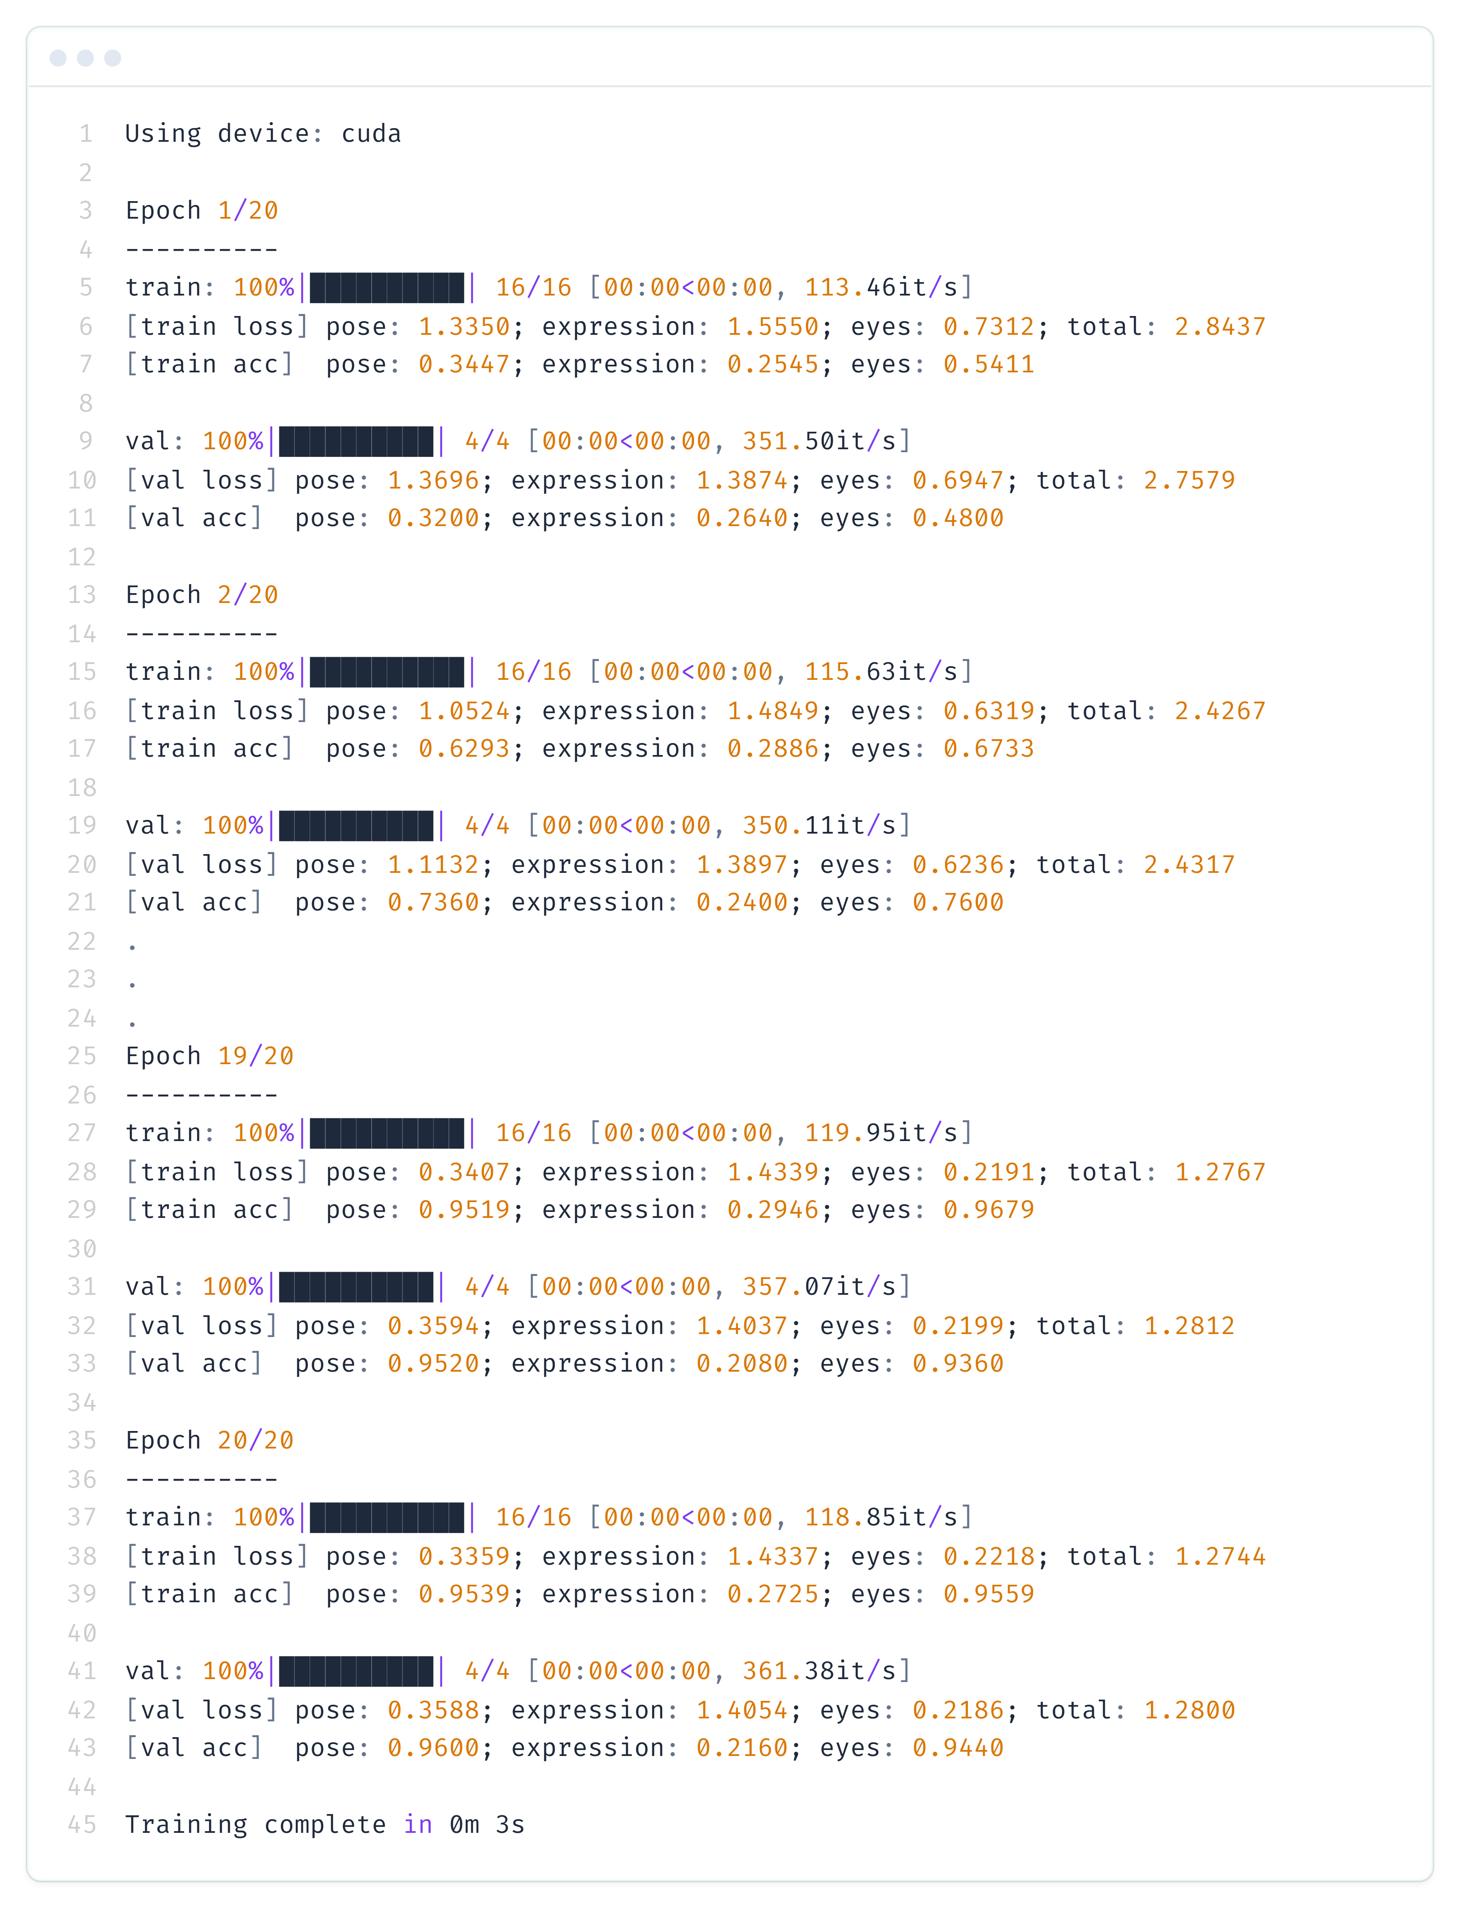
Train the model
Important features
Use cross entropy loss for each task
Stochastic Gradient Descent Optimizer
Train for 20 epochs with batch size of 32 and 80:20 train-test split
Fixed length lists for speed up
Leveraging the structure of file name to get the values for pose, expression, eyes
Return image (for visualization) and tuple(pose, expression, eyes)

Slide 9
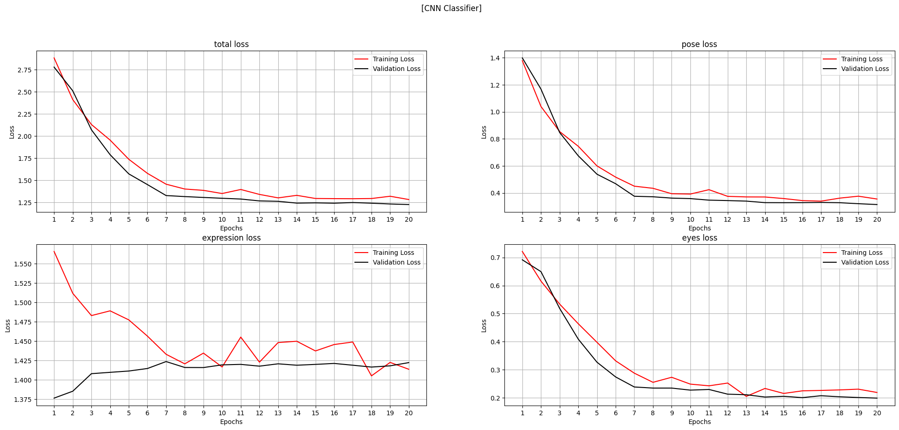
Loss Curve - CNN

Slide 10
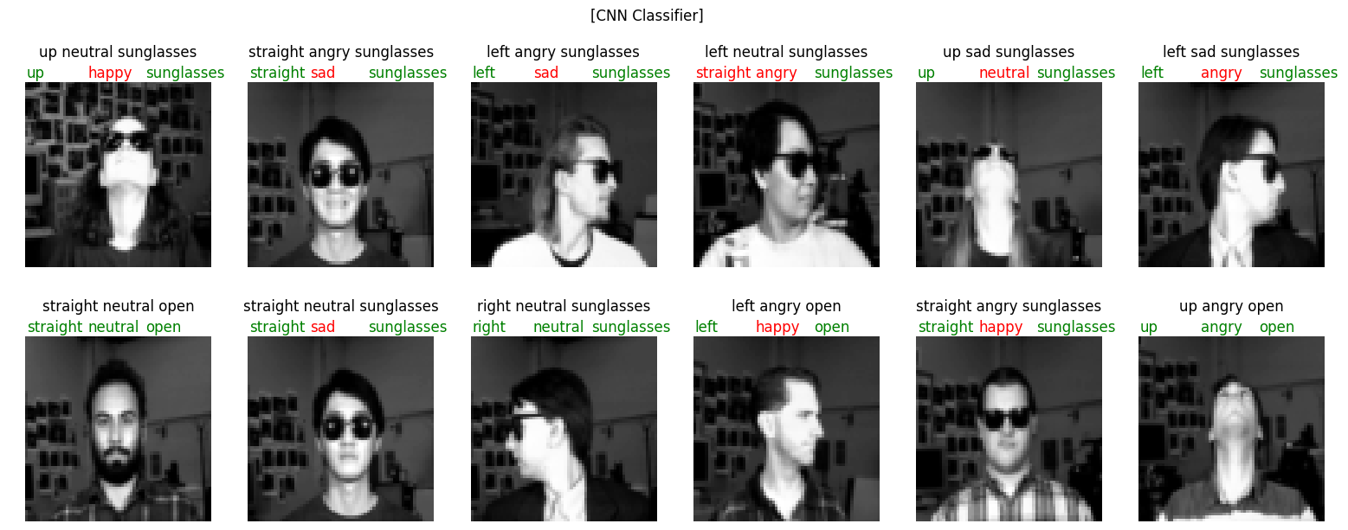
Predictions - CNN

Slide 11
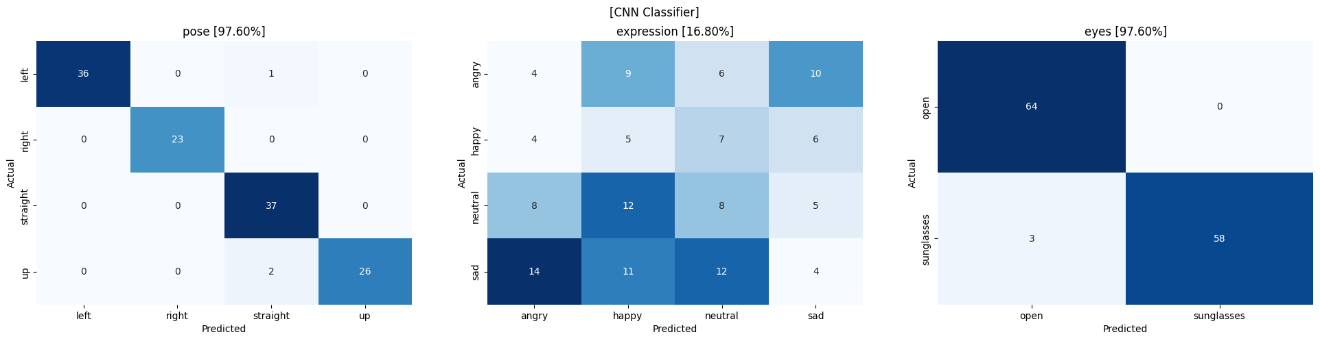
Predictions - CNN

Slide 12
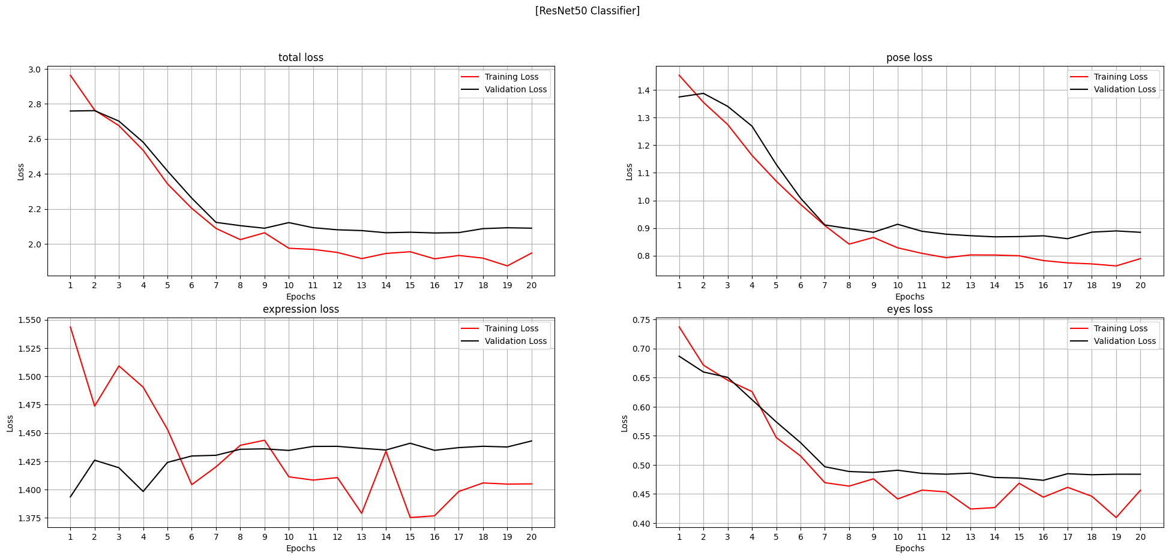
Loss Curve - ResNet

Slide 13
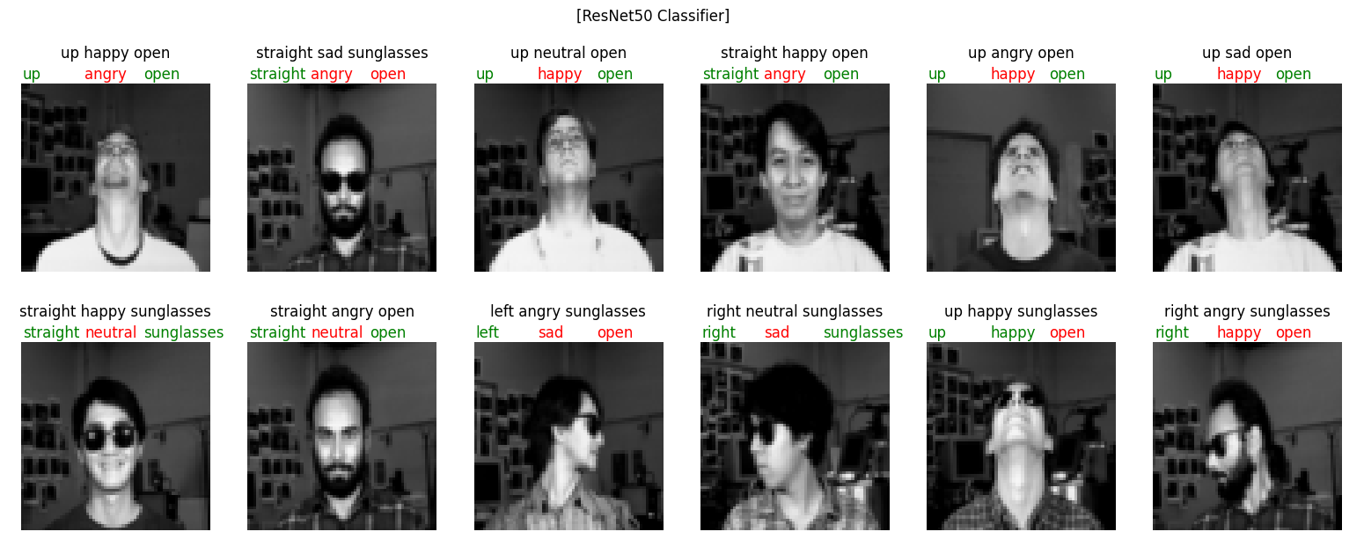
Predictions - ResNet

Slide 14
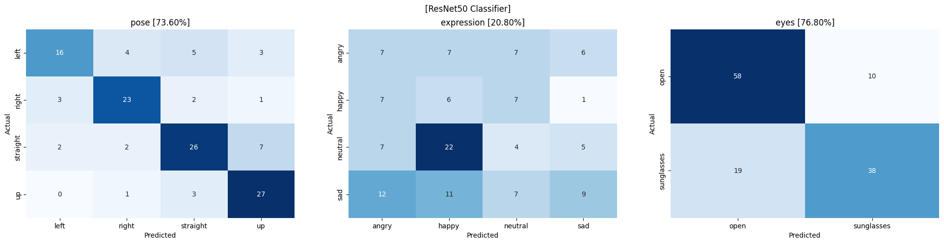
Predictions - ResNet

Slide 15
Cleanlab Studio
1
2
3
4
5
7
Select the Multi Class Classification
Import the data into the Studio
Create the project
Export the cleanset
Use the issues reported to create new label
Compare the results
6
Train the model on new label and compare the performance

Slide 16
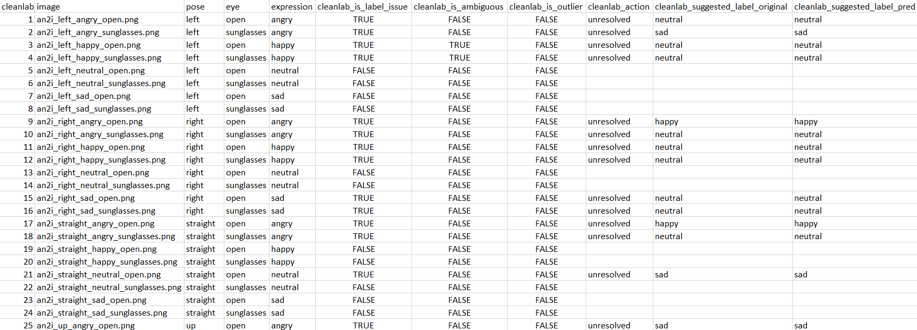
Cleanlab Studio

Slide 17
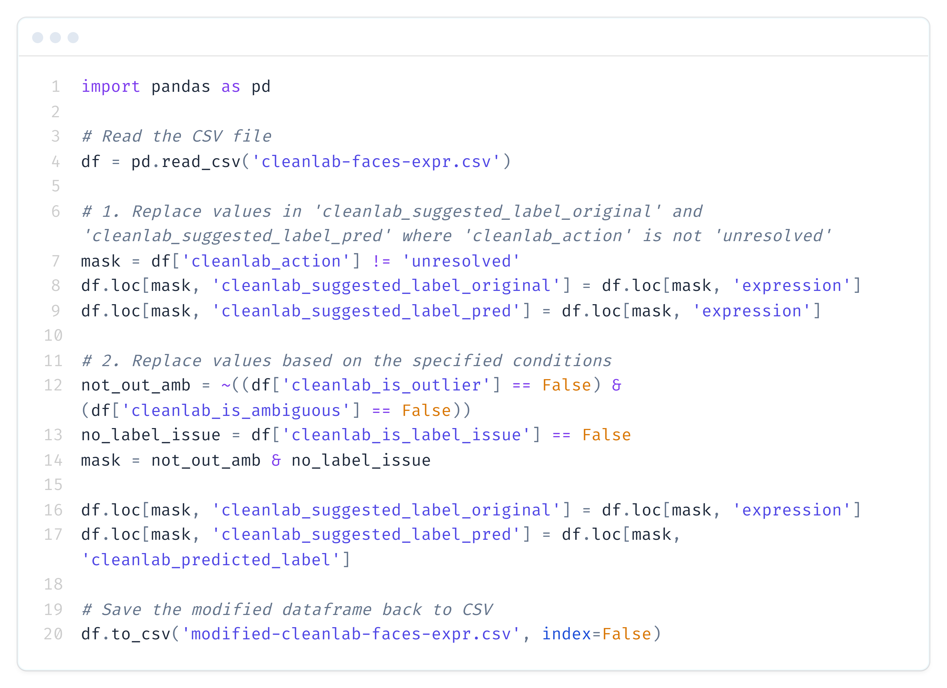
Cleanlab Studio
Since the performance for ‘expression’ is poor, so we will resolve issue for this task only
Some manipulation using masking, we create two additional labels ‘cleanlab_suggested_label_original’ and ‘cleanlab_suggested_label_pred’
Combine the resulting label into the dataloader class and rerun the models

Slide 18
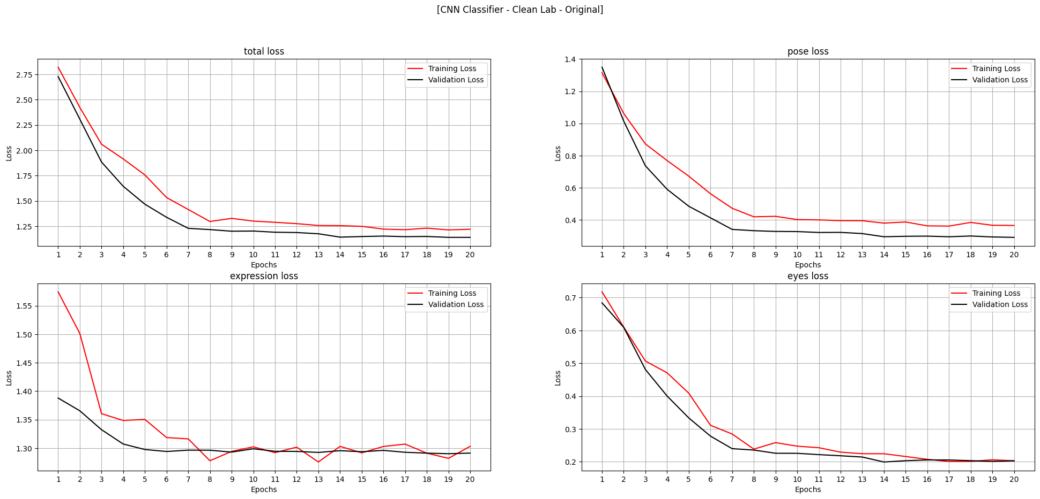
Loss Curves - CNN Cleanlab Original

Slide 19
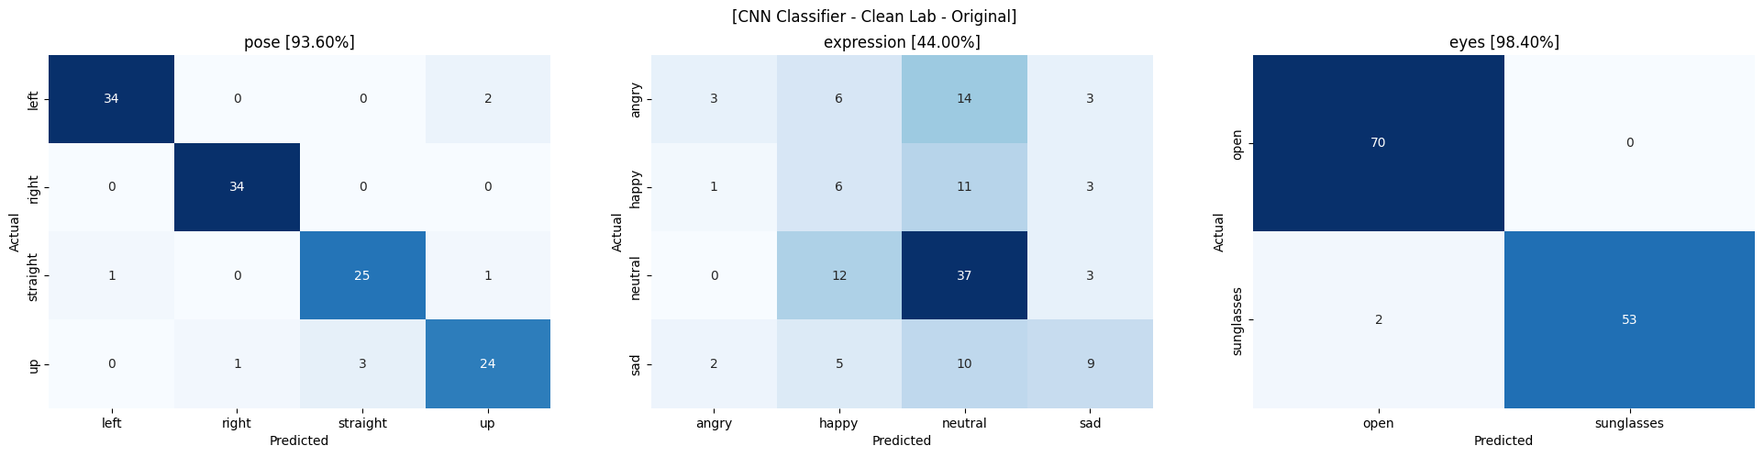
Prediction - CNN Cleanlab Original

Slide 20
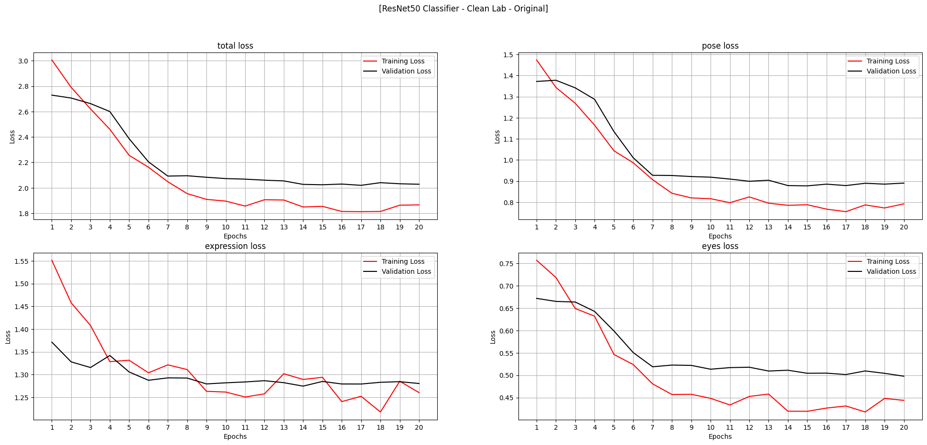
Loss Curves - ResNet Cleanlab Original

Slide 21
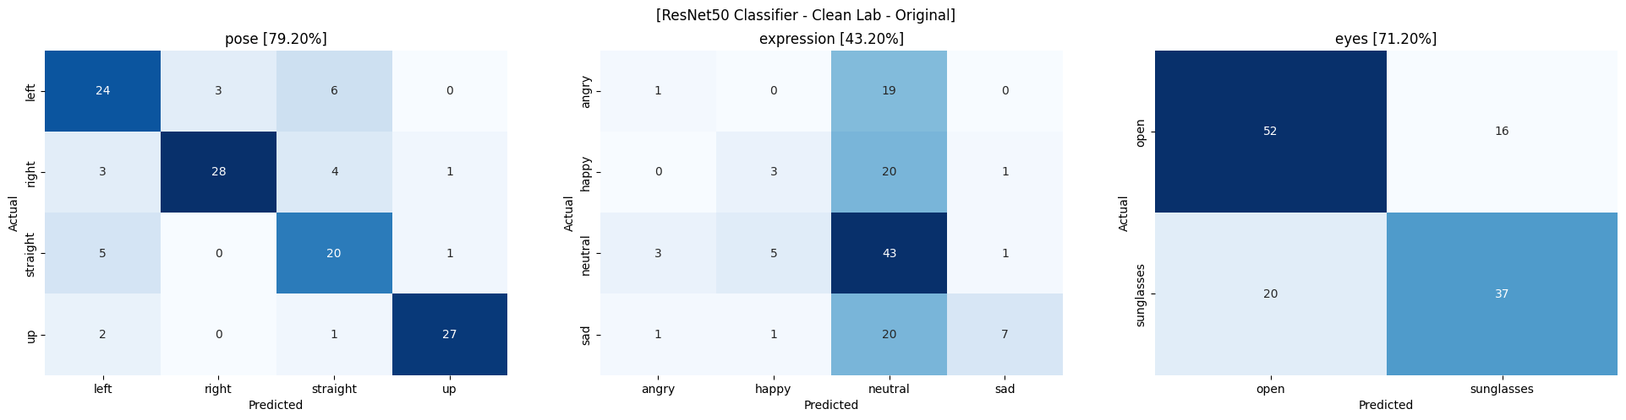
Prediction - ResNet Cleanlab Original

Slide 22
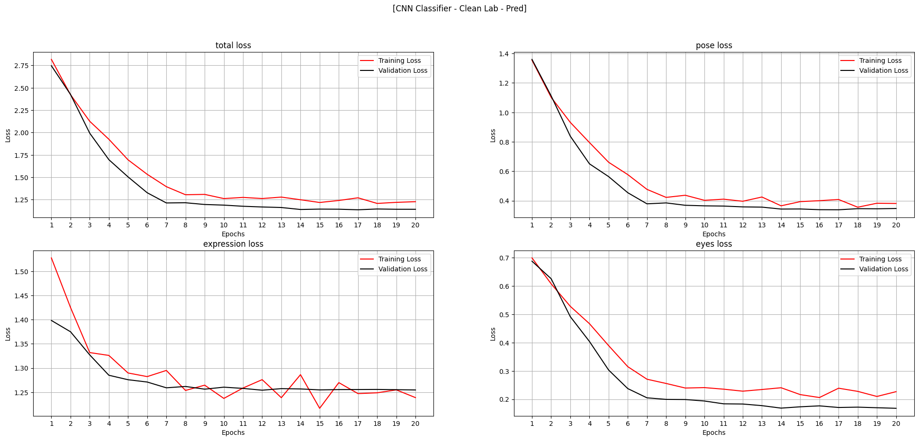
Loss Curves - CNN Cleanlab Pred

Slide 23
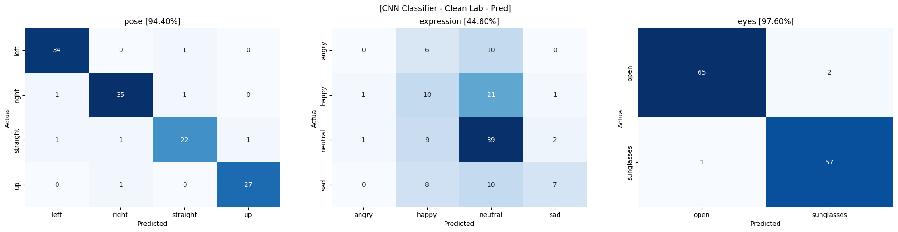
Predictions - CNN Cleanlab Pred

Slide 24
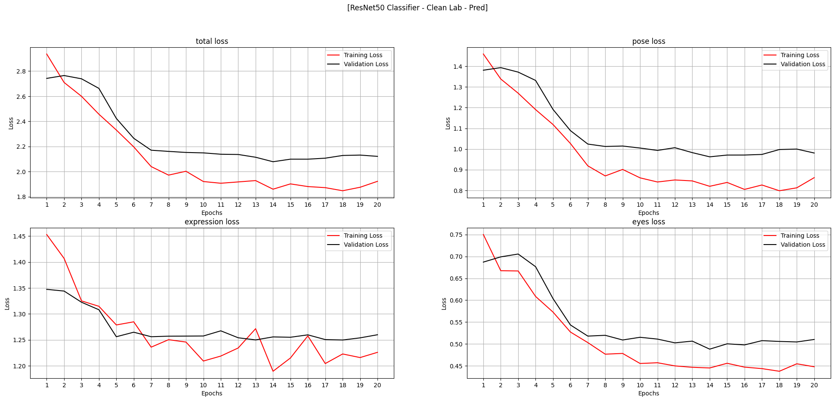
Loss Curves - ResNet Cleanlab Pred

Slide 25
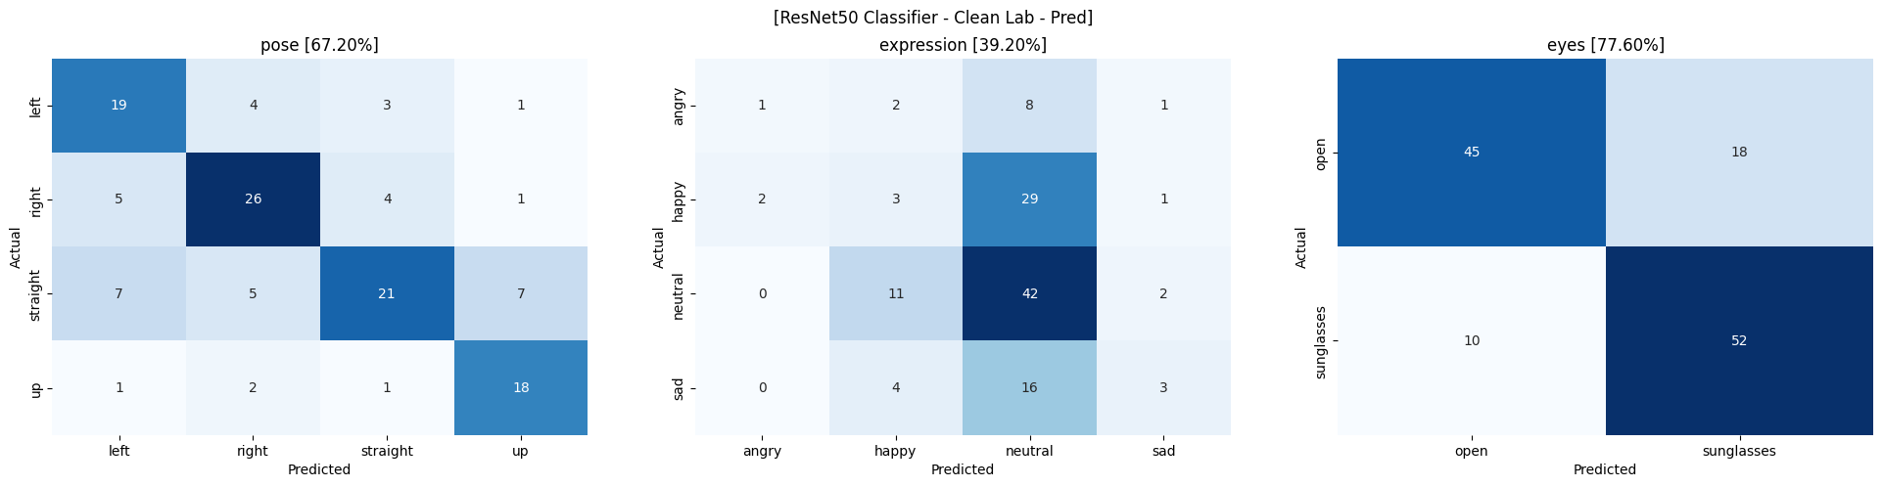
Predictions - ResNet Cleanlab Pred

Slide 26
Results
Label (expression) | Model | Accuracy (pose) | Accuracy (expression) | Accuracy (eyes)
Original | CNN | 97.6 | 16.8 | 97.6
Original | ResNet | 73.6 | 20.8 | 76.8
Cleanlab Original | CNN | 93.6 | 44.0 | 98.4
Cleanlab Original | ResNet | 79.2 | 43.2 | 71.2
Cleanlab Pred | CNN | 94.4 | 44.8 | 97.6
Cleanlab Pred | ResNet | 67.2 | 39.2 | 77.6

Slide 27
Conclusion
Replacing the ‘expression’ label with Cleanlab increased the accuracy for the task by 100%
Loss curve for the new labels for ‘expression’ task, starting following the downward pattern unlike the original where loss was increasing with epoch.
One thing to keep in mind that, due to label change, the distribution of label changed, here, neutral label increased.
Instead of using Studio (which uses their own ML model to raise label issues and suggest label change), one can use their own ML model through Datalab.
Also, Cleanlab doesn’t have facility for Muti task, multi class classification, hence, I just used ‘expression’ label, treating it as simple multi class problem.

